Slide 1


CITS1003 Introduction to Cybersecurity ChatGPT in Cybersecurity Dr David Glance
Dr David Glance

Slide 2
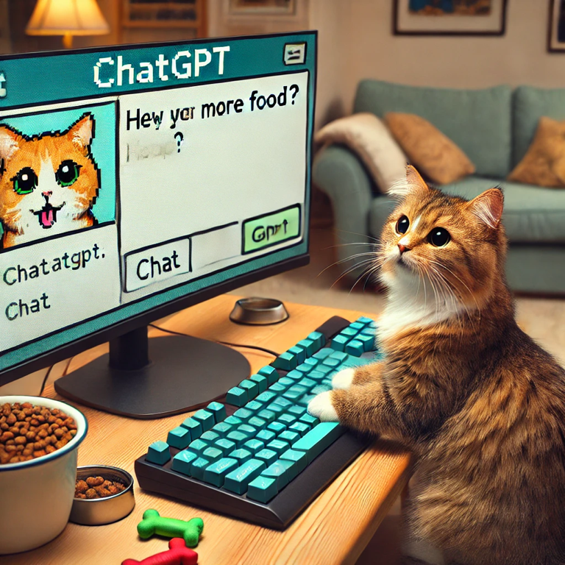
Cat asking ChatGPT for more food
Generated using ChatGPT 4o

Slide 3
3 Things
Understand what ChatGPT is
01
Understand how to use it effectively in Cybersecurity practice and study
02
Understand the “rules” or ethics of using it
03

Slide 4
Generative AI
Generative AI very large deep neural network with memory and attention
Generative AI is based on Large Language Models (LLM) or Foundation Models (FM)
Trained using very large amounts of text/images/sound
ChatGPT 3.5 trained using
Dataset | # tokens | Proportion within training
Web sites (Common Crawl) | 410 billion | 60%
Web Sites (WebText2) | 19 billion | 22%
Books1 | 12 billion | 8%
Books2 | 55 billion | 8%
Wikipedia | 3 billion | 3%

Slide 5
What ChatGPT does
Given a prompt as input, it predicts what word (token) would come next selecting the correct one from a weighted probability
“Who was Albert Camus?”
______?
Albert _____?
Albert Camus _____?
Albert Camus was _____?
Albert Camus was a _____?
Albert Camus was a French ______?
Albert Camus was a French author _____?

Slide 6
ChatGPT and Generative AI
Generative AI products:
DALL-E: Text to image synthesis
VALL-E: Text to speech synthesis
JukeBox, MusicLM, MuseNet: Text to Music synthesis
ChatGPT is based on LLM GPT-3.5/4
GPT-3.5: 175 billion parameters 300 billion words or 570 GB data
GPT-4: 1.76 trillion parameters
It is trained in a semi-supervised way – people telling it what it got right and wrong and feeding this back

Slide 7
Issues with ChatGPT
When regarding issues with Generative AI, question posed is whether this is different from a human response
Currency: Training data only goes up to 2022
Compensated for by its ability for few-shot learning
Hallucinations
Can generate responses that are incorrect and there is often no way of knowing
Same true for humans? Humans may know that they don’t know – Generative AI doesn’t and can’t

Slide 8
Issues with ChatGPT (Cont…)
Privacy
Opt-out clause for prompts and responses not to be reused in training
Legal issues
Copyright concerns around training data
Liability for output
Bias
Bias comes from training data – the more you have, the less of a problem this may be
Can be potentially detected and adjusted
“Create an image of 5 powerful people”

Slide 9
Things you can use it for
Explain how to do something:
Write code in a particular language
Write scripts that will run programs
Instructions on how to run a command line application (e.g. network scanning)
How to use commands in an unfamiliar environment e.g. Linux
Explain how something works:
Explain how a bit of code or script works
Explain a concept e.g. threats/vulnerabilities/risk
Explain why a bit of code may be wrong and allow it to be exploited

Slide 10

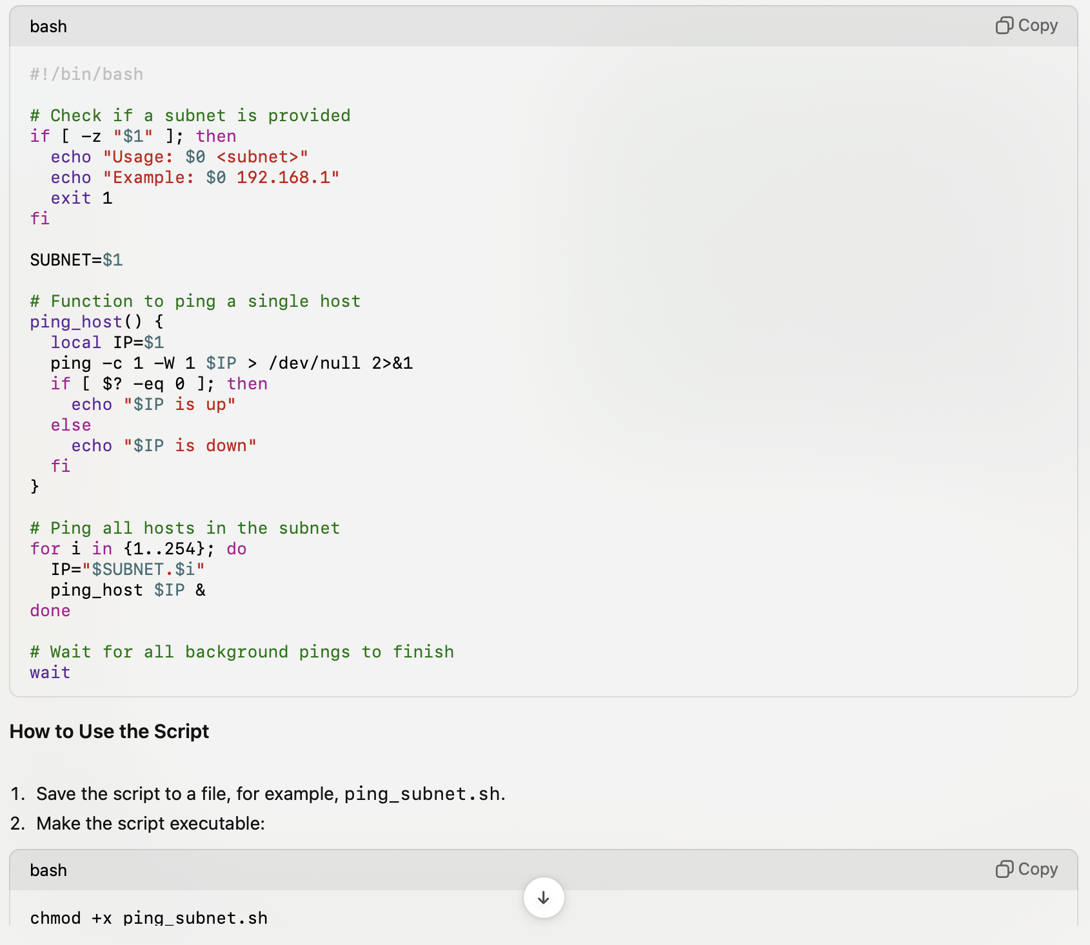
Write a script
Write a bash script that will ping a subnetwork and check the response to see if a host is up. The subnetwork is provided as an argument to the script.

Slide 11
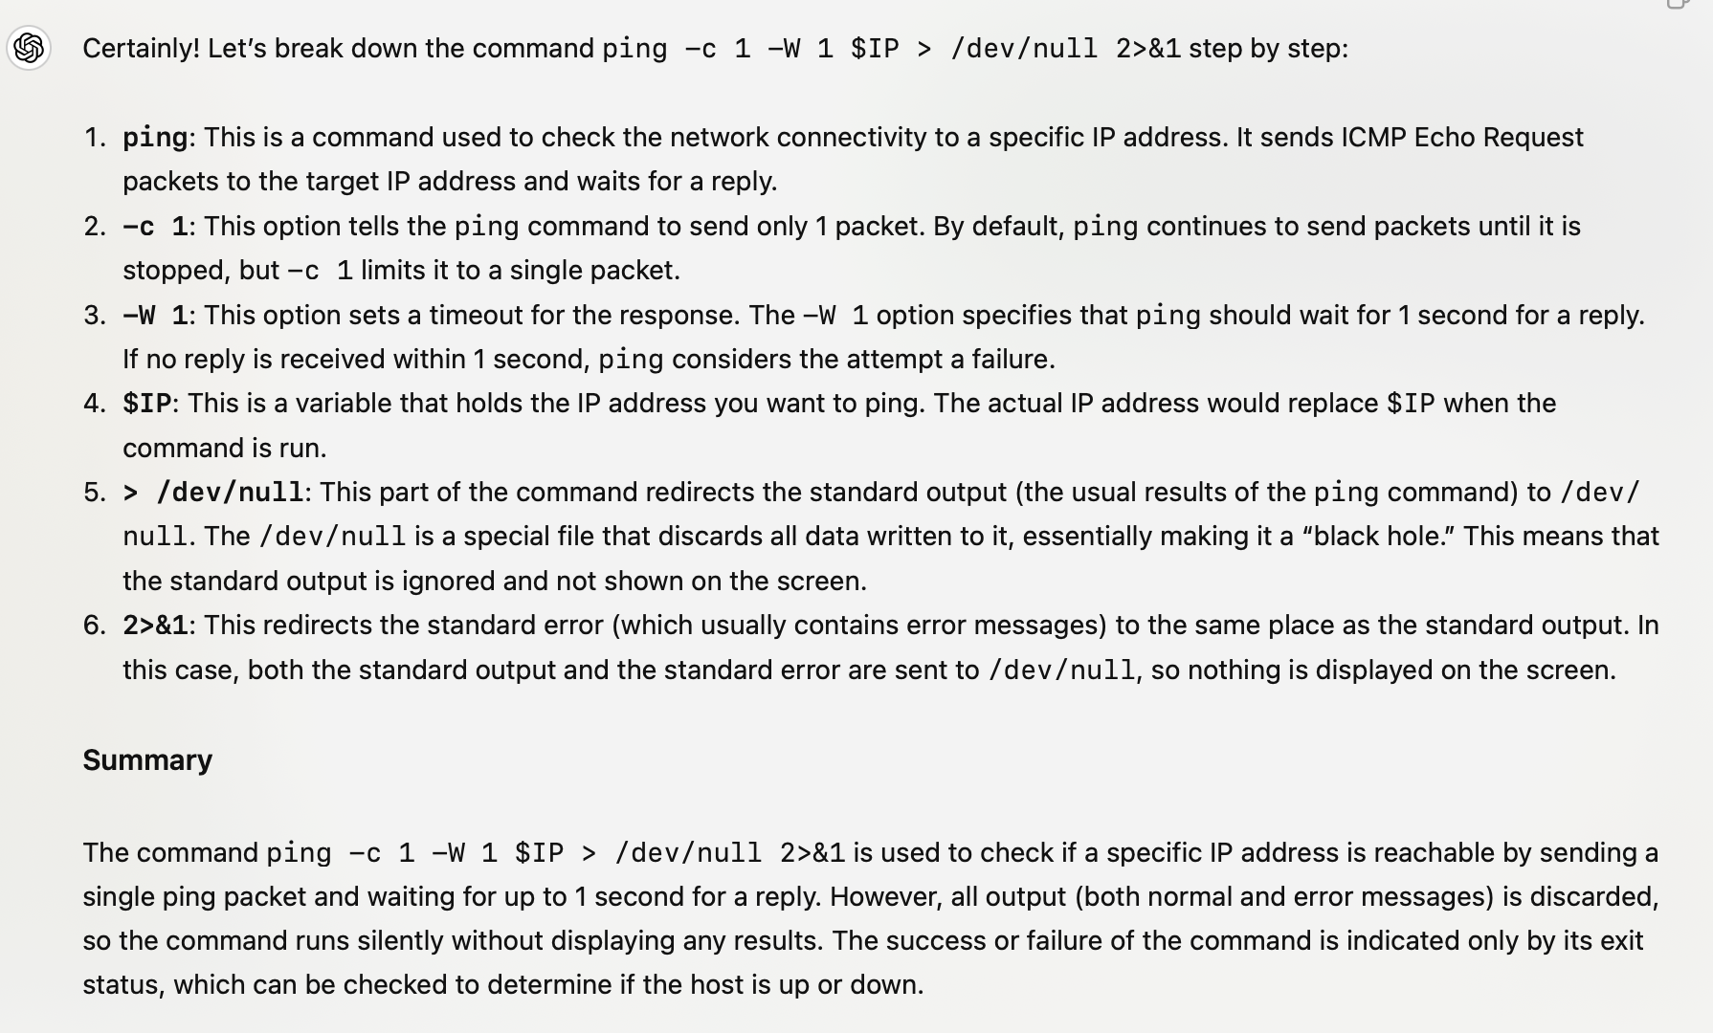
Explain Code
Explain to a programming novice what the following bash command is doing "ping -c 1 -W 1 $IP > /dev/null 2>&1"

Slide 12
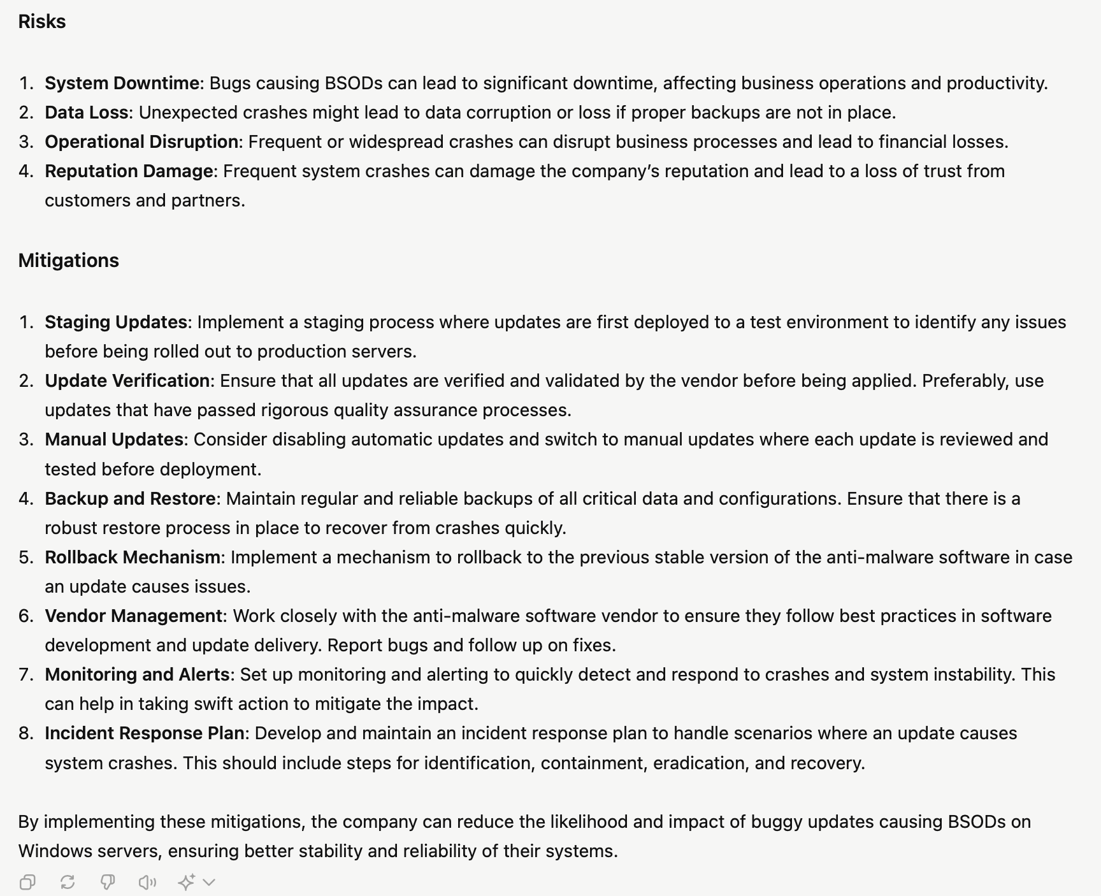
Explain Cybersecurity concepts
In the following scenario, describe the threats, vulnerabilities, risks and mitigations: "A company is running anti-malware software on Windows servers that accepts automatic updates. Anti-malware software that has bugs in it is capable of crashing Windows machines causing a blue screen of death"

Slide 13
Things you can use it for
Brainstorming:
Write pros and cons around a topic
Create structure of an essay, paper
Suggest titles
Suggest topics
Get it to help:
Translate text from one language into another
Correct grammar and tone
Create a study plan
Write code
Write questions and answers around a topic
Create a summary of a meeting

Slide 14
Constructing Prompts
Specify the “voice”
Professional
Casual
As a software developer, a scientist
Think of the audience
Plain English, young audience, experienced
Give the context
“A company is assessing whether to implement cybersecurity processes. The head of the cybersecurity team is preparing a report for the CEO to take to the Board of the company. In the document, he wants to outline the critical importance of implementing good cybersecurity practice. The company almost suffered a ransomware attack this year.”

Slide 15
Constructing Prompts
Write specific instructions
Ask for a set number of points
Ask for pros and cons
Iterate – request corrections or revisions
Be clear on format of output
Length: The answer should be 100 words, 10 sentences, 500 characters.
Format: Bullet points, table of the output, as a letter, as a report, code, HTML
Create output for other programs
Limits: only 5 points

Slide 16
Use it responsibly
Learn how to use it and how to use it responsibly – it will help and assist
Seek permission if not explicitly given to use it in work
Create a statement of use of AI in your work (Acknowledging AI tools and technologies (unimelb.edu.au))
Check it in Turnitin if you are unsure.

